Slide 1

How to program a firmware with a programming cable
Document No. 930-00212
Rev 1.42

Slide 2
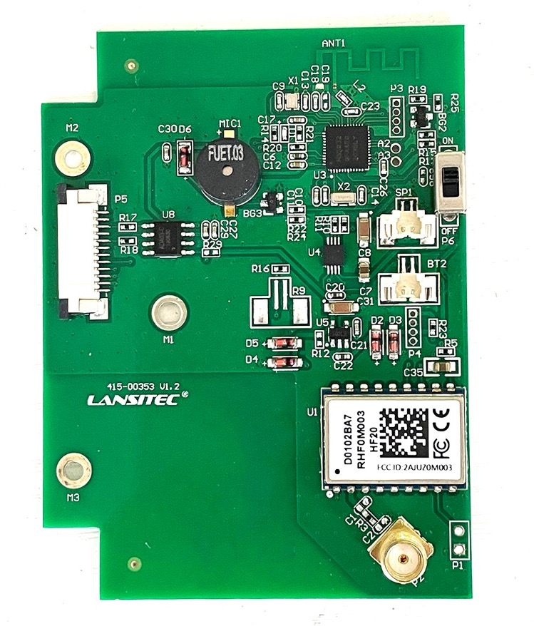
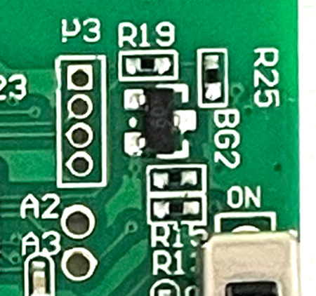
PREPARATIONS
Definition of the Pins on Solar BLE Gateway
VCC
SWDIO
SWCLK
GND
In all of the interfaces we use, VCC is the square one

Slide 3
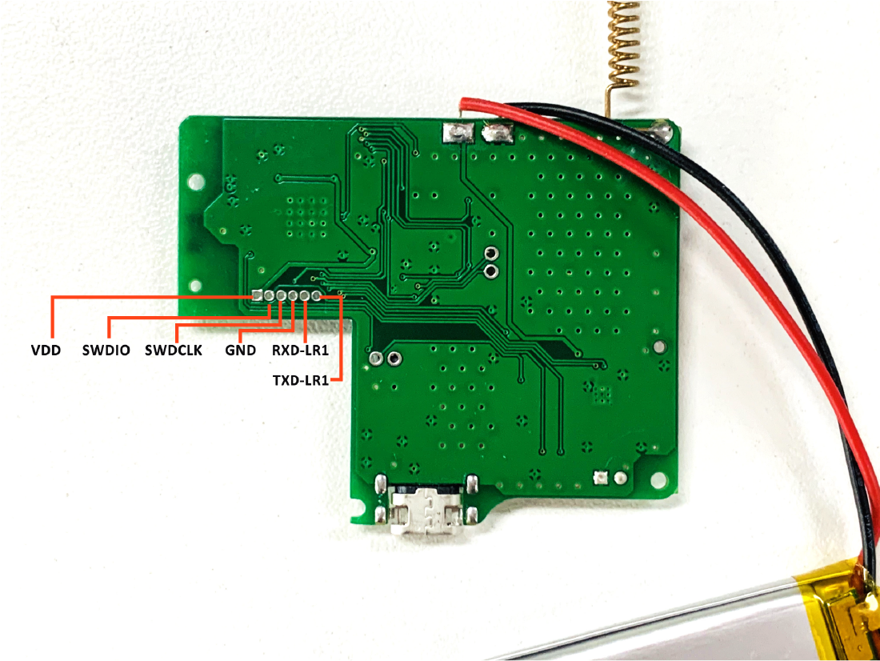
PREPARATIONS
Definition of the Pins on Badge Tracker

Slide 4
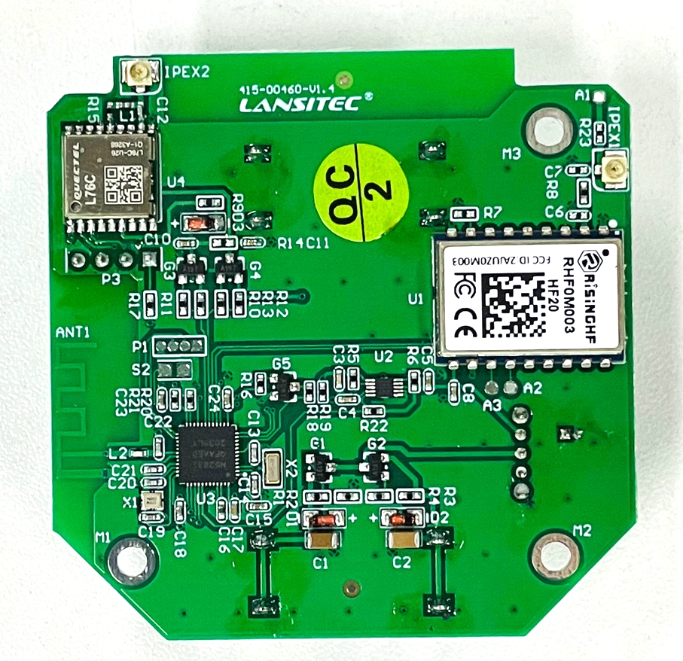
PREPARATIONS
Definition of the pins on Asset Management Tracker
VCC
SWDIO
GND
SWCLK

Slide 5
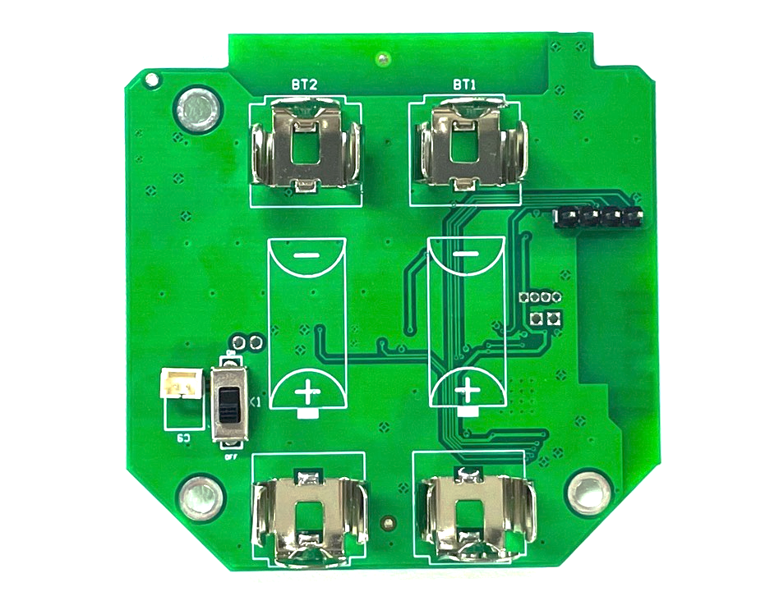
PREPARATIONS
Definition of the pins on Asset Management Tracker
VCC
SWDIO
GND
SWCLK

Slide 6
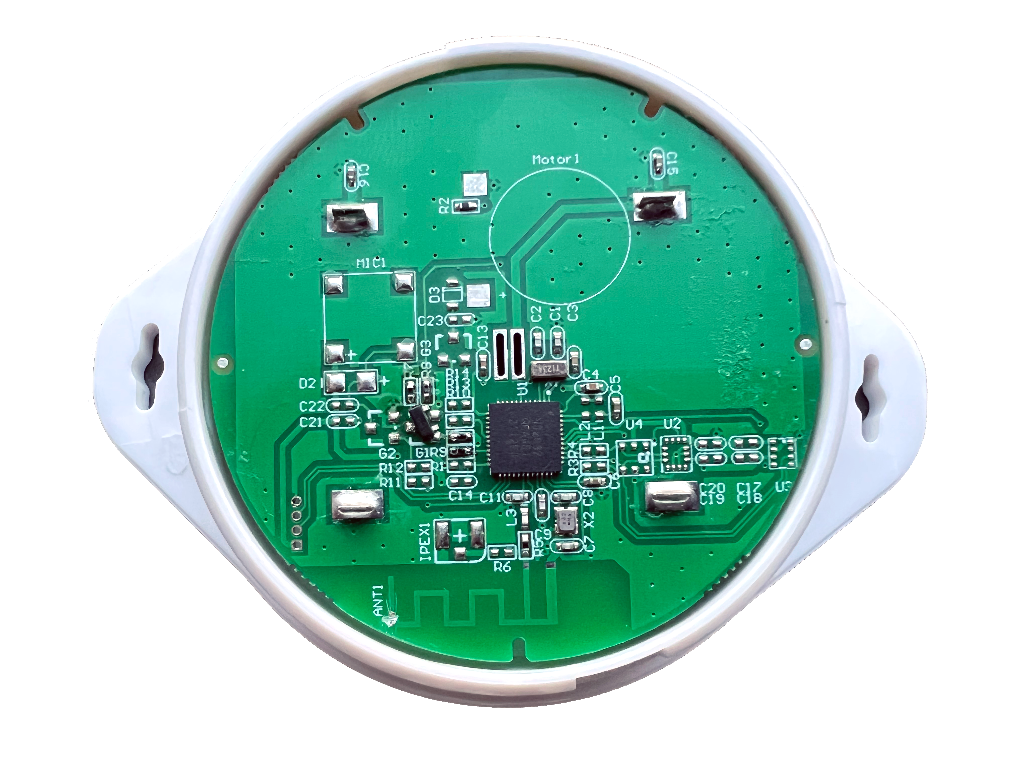
PREPARATIONS
Definition of the pins on iBeacon
GND
SWCLK
SWDIO
VCC

Slide 7
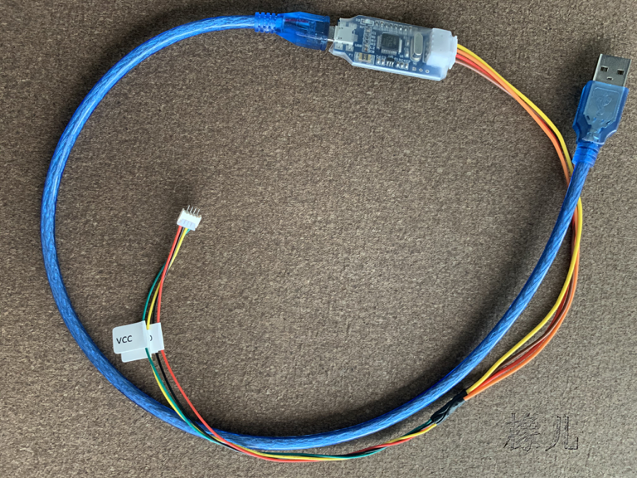
The cable

Slide 8
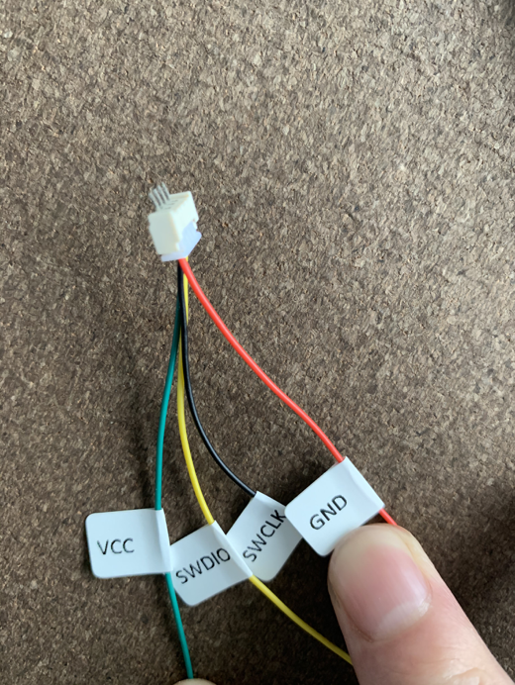
Definition of pins on the cable

Slide 9
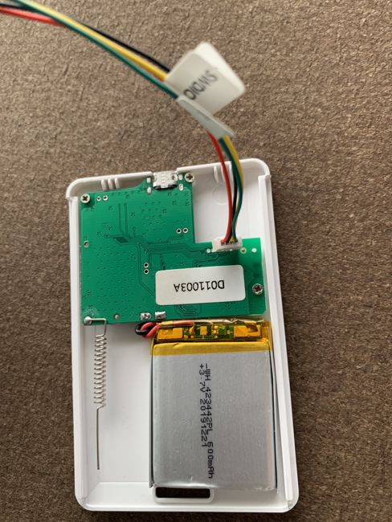
Use the connector to connect the PCB.
Then program the firmware according to the following steps beginning from page 10.
Badge Tracker PCB

Slide 10
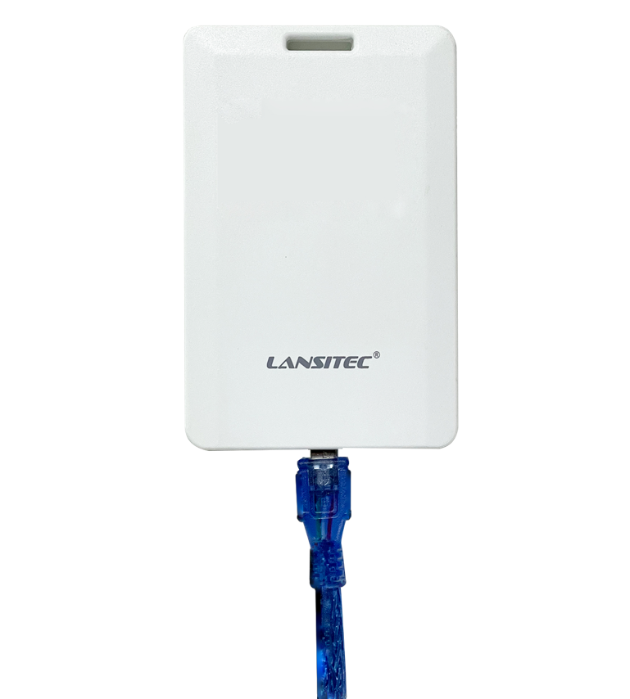
Connect the micro USB cable to the badge.
Then program the firmware according to the following steps beginning from page 10.
Badge Tracker

Slide 11
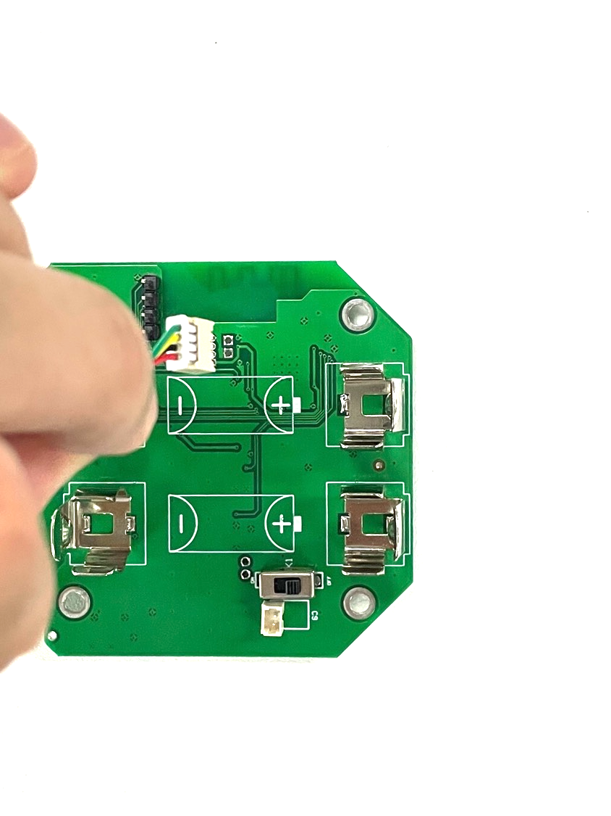
Use the connector to connect the PCB .
Then program the firmware according to the following steps beginning from page 10.
Asset Management Tracker PCB

Slide 12

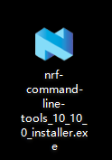
STEP ONE : Download the software
1. Follow the link to download the software.
https://www.nordicsemi.com/-/media/Software-and-other-downloads/Desktop-software/nRF-command-line-tools/sw/Versions-10-x-x/10-10-0-v2/nRF-Command-Line-Tools_10_10_0_Installer.exe
2. Unzip the files and get the software nRF-Command-Line-Tools_10_10_0_installer.exe.

Slide 13
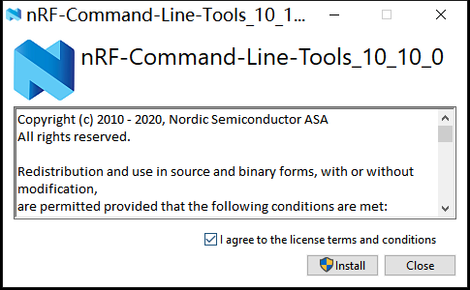
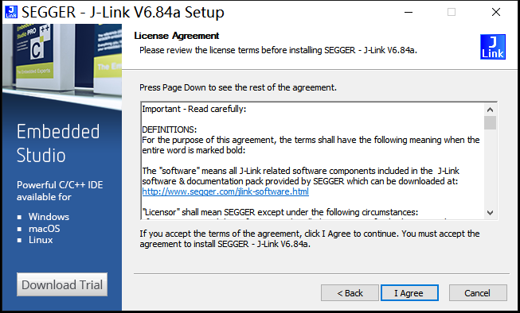
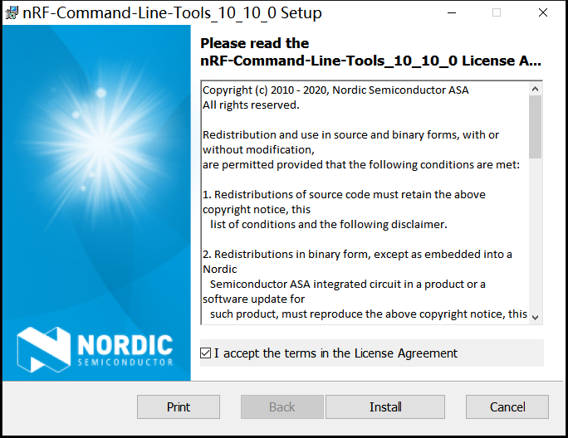
3.Install the software in three steps.

Slide 14
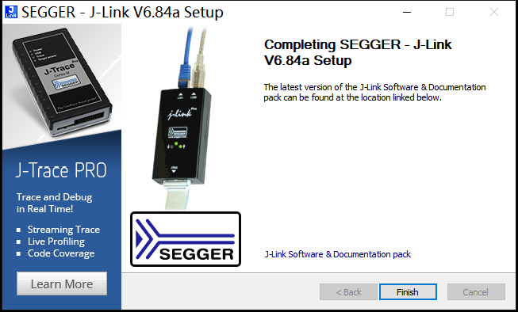
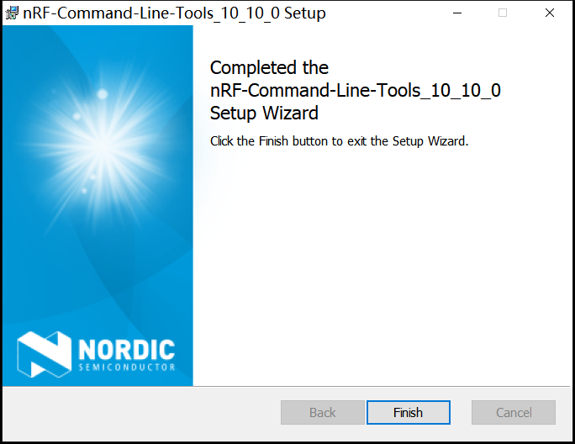
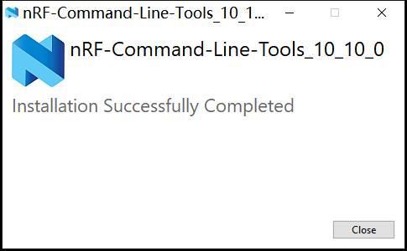
3.Wait for the installation to complete, and click the finish button to exit.

Slide 15
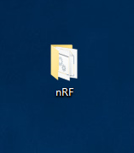
STEP TWO : Program the firmware
1. Make a copy of the nRF folder to Desktop.
(Please contact us to get this folder)

Slide 16
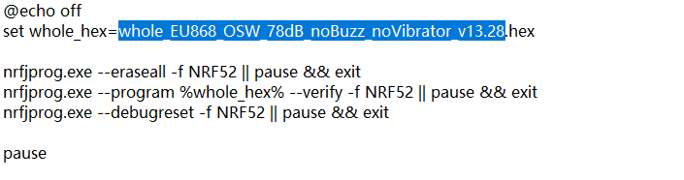

Slide 17
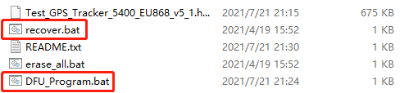
2. Click on script recover.bat to recover readback protection.
3. Click DFU_Program.bat to program the firmware.

Slide 18
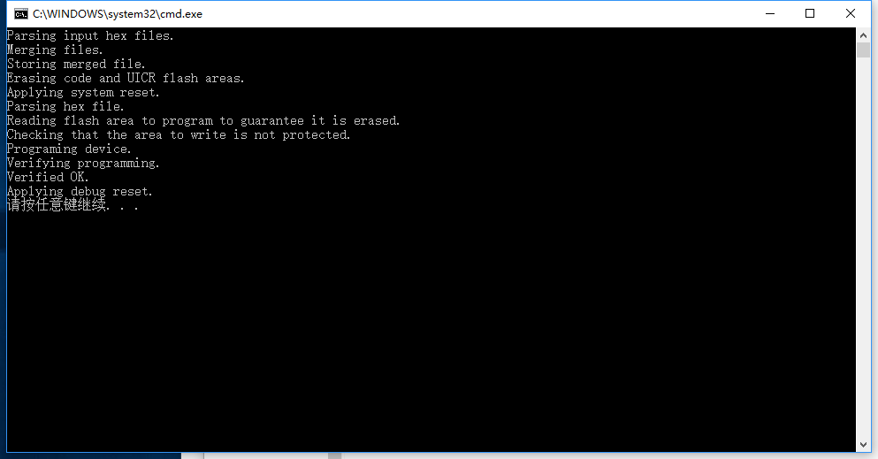
4. The programming starts automatically. When it finishes, you should be able to hear a beeping voice from the tracker.
Press any key to continue.

